Slide 1



SMART INDIA HACKATHON 2026
TRIBAL SCHOLARSHIP
  Problem Statement ID – SIH26238
  Problem Statement Title - Unified Scholarship Mobile
  Application for Tribal Students
  Theme - Smart Automation
  PS Category - Software
  Team ID - DCSIH1141
  Team Name – INFINOVA DACE

Slide 2
INFINOVA
PROBLEM STATEMENT
Who faces this problem ?
Tribal students, particularly those from
rural, remote, and underserved areas, who often have limited access to reliable scholarship information and digital support.
What problem are you solving ?
Tribal students face difficulty in discovering suitable scholarships, understanding eligibility criteria, completing applications, and tracking their application status across multiple platforms.
Why is it so important?
Lack of awareness, complex eligibility
requirements, repeated paperwork, and scattered information can cause eligible students to miss valuable financial support for their education.
Our Solution
Tribal Scholar is a unified, student-friendly platform that brings scholarship discovery, eligibility checking, application guidance, and application tracking together in one place
2

Slide 3
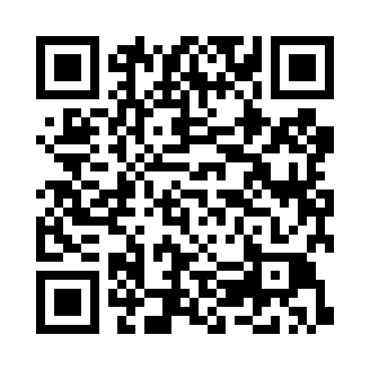
TECHNICAL APPROACH
INFINOVA
Tech Stack
Frontend
Backend
Styling
Deployment
React.js
TypeScript
HTML & CSS
Node.js
Express.js
CSS
JavaScript
Vercel
System Architecture Flow
Student/Admin Browser
Access the web
Frontend
React + TypeScript
Built with Vite
Backend
Node.js + Express.js
(REST API)
Data Storage
Schemes & Application Records
Key Features Implemented
Eligibility Calculator
Scholarship Scheme List
Student/Admin Module
Access Control
Demo Video :
Click Here
Discover our solution
3

Slide 4
FEASIBILITY AND VIABILITY
INFINOVA
TECHNICAL FEASIBILITY:
POSSIBLE CHALLENGES AND SOLUTIONS:
Uses commonly available web/mobile technologies, databases and APIs.
The system can be connected with existing scholarship and digital-document services.
Student information and documents can be stored and managed securely.
Challenge | Our Approach
Different Government Systems | Connect through APIs
Document/Verification mismatch | Standardized document checklist per scheme
Data Security | Secure storage & access control
Application confusion | Step by step guidance
Poor internet connectivity | Lightweight , mobile-friendly design
IMPLEMENTATION PLAN:
Implementation Plan:
Phase 1 — Build: Develop the student profile, scholarship search, document management and application tracking.
Phase 2 — Integrate: Connect with relevant government services and verification systems through authorized APIs.
Phase 3 — Test & Deploy: Test with students and institutions, fix issues, and gradually expand the platform.
KEY TAKEAWAY :
Easy scholarship discovery
Quick Eligibility check
Secured Student access
4

Slide 5

IMPACT AND BENEFITS
INFINOVA
Who Benefits?
Tribal Students
Parents and Families
Schools and Colleges
Government Bodies
Expected Impacts
Higher Scholarship Uptake
Fewer Rejected Forms
Reduced Missed Deadlines
Transparent Tracking
Real-World Applications
Tribal Welfare Depts
EMRS and ashram Schools
NGOs and CSR
Future Scopes
Additional Features
Student/Admin access
Admin Analytics
In app notifications
Student Support
Application Status Tracking
Deadline Reminders
Scholarship Guidance
Offline Mode
SMS alerts
Voice assistant
5

Slide 6
RESEARCH AND REFERENCES
INFINOVA
Ministry of Tribal Affairs – Scholarship Schemes Overview
https://tribal.nic.in/ScholarshiP.aspx
National Overseas Scholarship Portal
https://overseas.tribal.gov.in/
DBT Tribal Portal (Pre/Post Matric Scholarships)
https://dbttribal.gov.in/
National Fellowship Portal
https://fellowship.tribal.gov.in/
National Scholarship Portal (NSP)
https://scholarships.gov.in/
THANK YOU
6

